Slide 1
Case Study

Slide 2
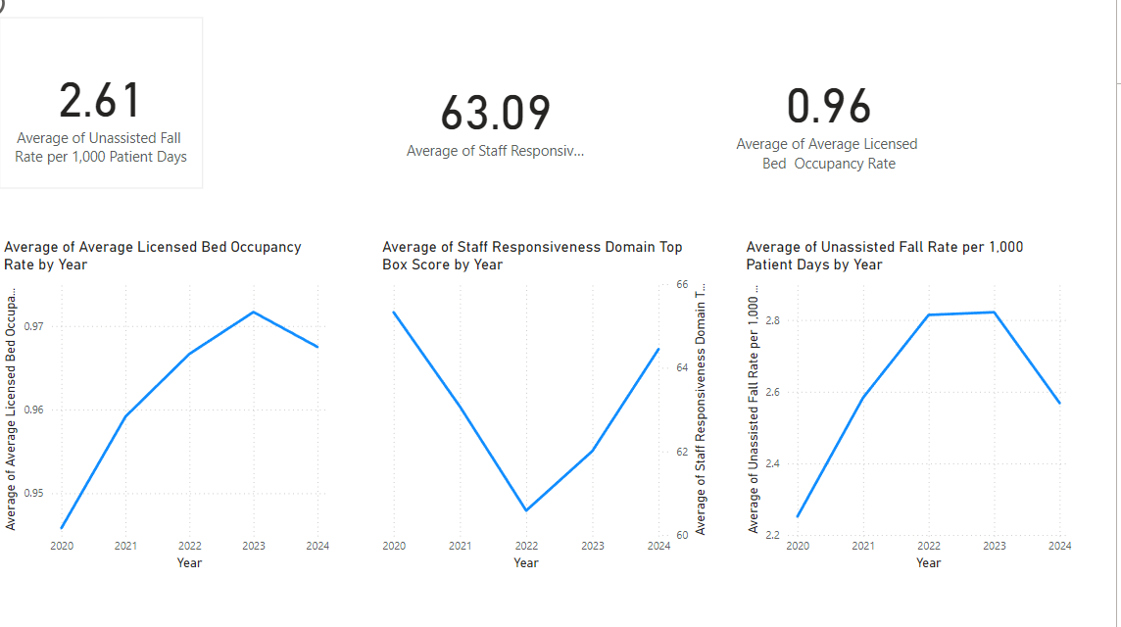
Page 1 Kpi’s

Slide 3
Outcomes
Average Licensed Bed Occupancy Rate is increasing by Year
Staff is becoming less responsive as compared to previous year
or we can Just say Average of Staff Responsiveness Domain Top score
Is also decreasing by year
Unassisted Fall % is inceasing by year

Slide 4
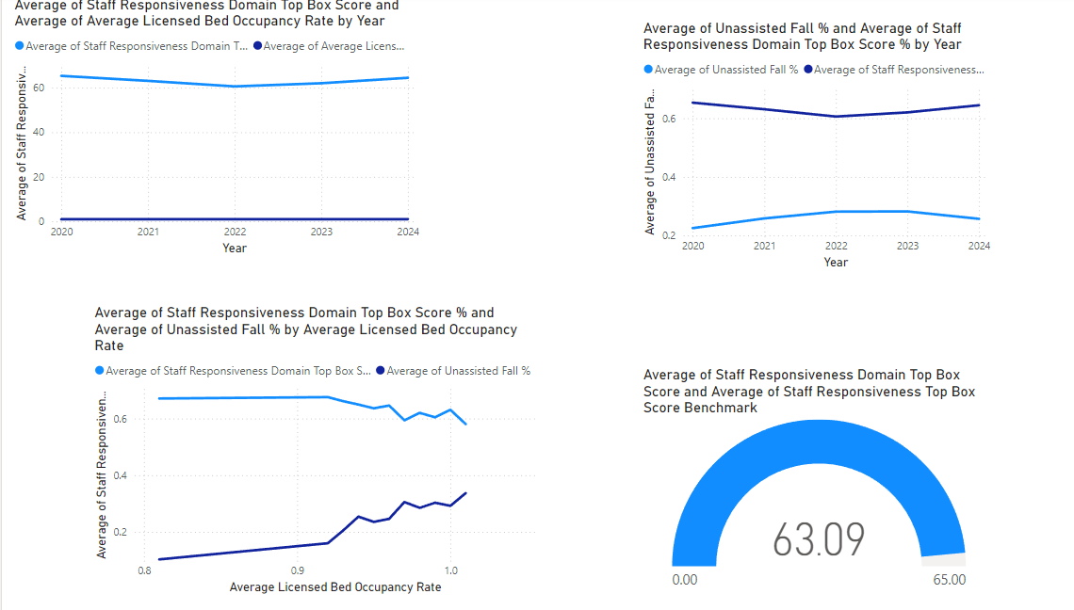
Page 2 Kpi’s

Slide 5
Outcomes
Average bed Occupancy is increasing by the time and Staff is becoming less responsive. i.e responsiveness is lower during high occupancy, it may indicate that staff struggle to manage workloads.
Unassisted Fall % is increasing by year and Staff Responsiveness is decreasing i.e fall rates rise during low responsiveness periods, there’s a safety concern.
Gauge Chart
The average Staff Responsiveness Top Box Score (63) is below the benchmark (65). This indicates that the hospital's staff responsiveness is underperforming by 2 points compared to the industry or internal benchmark. The hospital's staff responsiveness needs improvement to meet or exceed the benchmark.

Slide 6
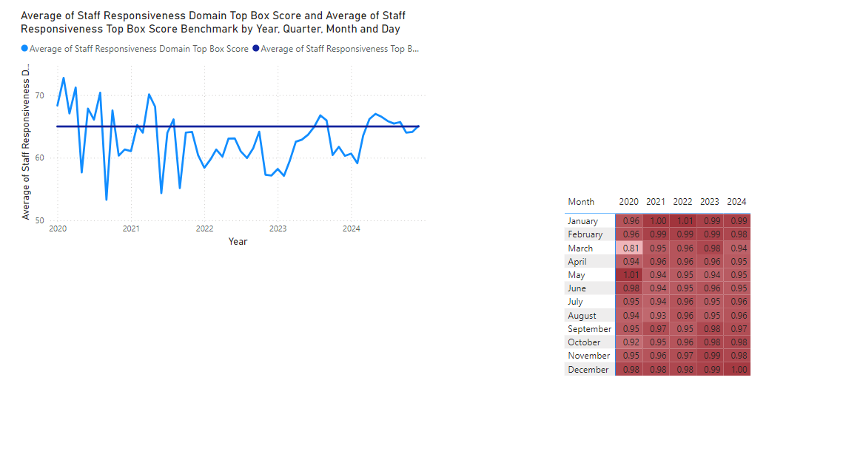
Page 3 Kpi’s

